Slide 1

BUSINESS Communication
- Presented by JAIKANTH S

Slide 2

Business communication refers to the process of sharing information within and outside of a company. It encompasses various forms, including verbal, non-verbal, written, and digital communication, and is essential for the efficient operation and success of a business.
Why Business Communication
Aspire
2
Notes:
Why we use business communication
because, it is efficient and ensure clarity and productivity
by understanding common business phrases helps in better collaboration and understanding in professional life. In this ppt we are going to see about 10 phrases and I will tell the meaning of each phrase and an example of where we can use that. So lets start

Slide 3
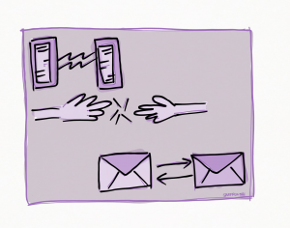
“Keep Me in the Loop”
To “keep me/you/her/him/them in the loop” means to keep someone informed and updated about developments in a project or situation. This ensures that everyone involved is aware of the progress and any changes that occur.
Aspire
3
Notes:
Def: keeping someone involved and updated about developments
Ex: please keep me in the loop on the project status

Slide 4

“Forward
Planning”
Forward planning refers to the strategic process of anticipating future needs, challenges, and opportunities, and preparing for them in advance. It involves setting long-term goals, developing plans to achieve them, and considering potential risks and contingencies.
Aspire
4
Notes:
Def: planning ahead for future needs or events
ex: we need to focus on forward planning for our goals for the next three months

Slide 5

“At the End of the Day”
“At the end of the day” means considering the overall situation or the most important aspect after all factors have been considered. It is used to summarize the most crucial takeaway or conclusion from a discussion or situation.
Aspire
5
Notes:
Def: considering the most important aspect of all factor
ex: At the end of the day, customer satisfaction is our priority

Slide 6
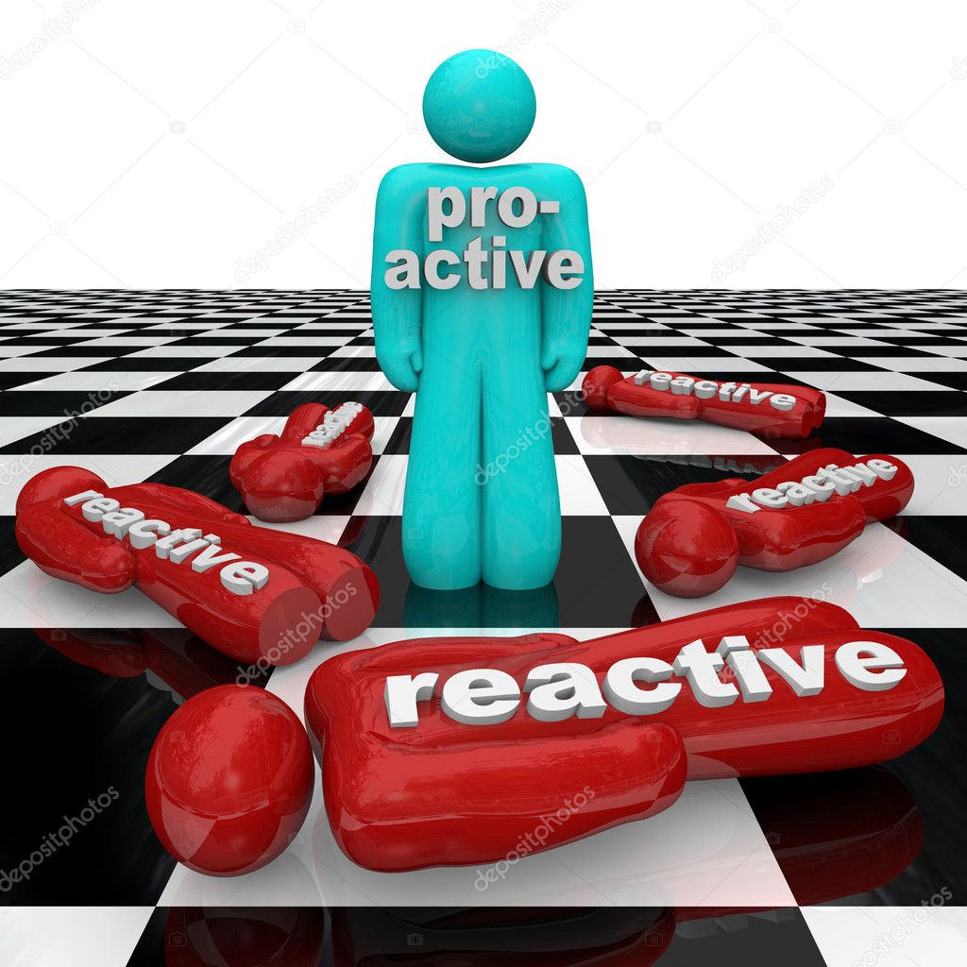
“Proactive”
Being "proactive" means taking the initiative to address potential issues or opportunities before they arise, rather than waiting for them to happen and then reacting. It involves anticipating future challenges and acting in advance to mitigate them.
Aspire
6
Notes:
Def: Taking initiative without waiting for direction
EX: Being proactive can help prevent problems before they arrive

Slide 7
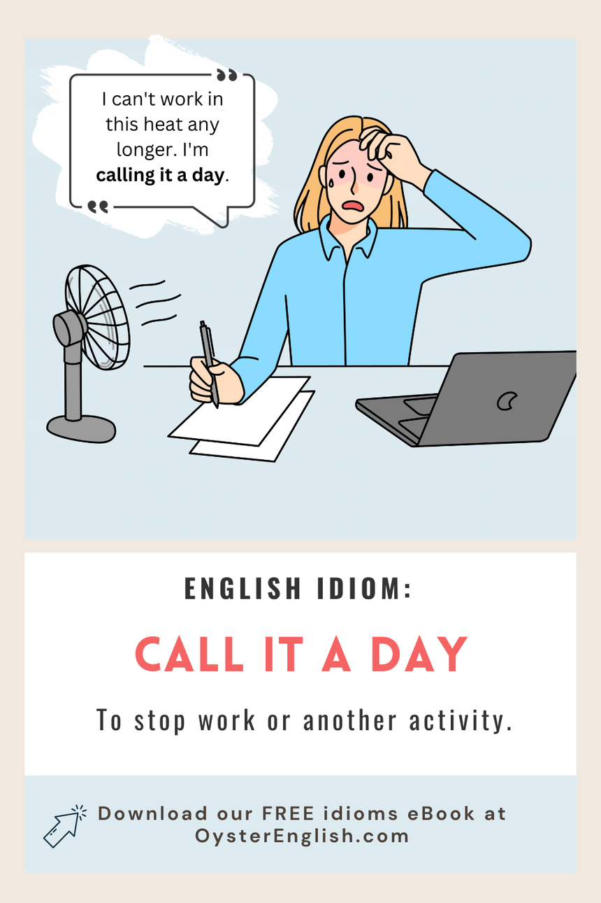
“Call It a Day”
To "call it a day" means to stop working on a task, project, or activity for the rest of the day because a satisfactory point has been reached or because further progress requires more time and energy than available.
Aspire
7
Notes:
Def: stopping work for the day after reaching a good stopping point.
EX: its late, lets call it a day and continue tomorrow.

Slide 8

“Workflow”
"Workflow" refers to the sequence of steps and processes through which a task or set of tasks is completed within an organization. It involves the flow of work from one stage to the next, including the tasks, dependencies, and timelines involved.
Aspire
8
Notes:
Def: sequence of task, it involves workflow of the task and completion of task within timeline
ex: improving the workflow can increase efficiency

Slide 9

“Touch Base”
To "touch base" means to make brief contact with someone to update them on the status of a project, discuss progress, or ensure alignment on ongoing activities. It often involves checking in to maintain communication and address any issues.
Aspire
9
Notes:
Def: keep someone updated on development
EX: lets touch base next week to review the progress here this phrase and the keep me in the loop may sounds similar keep me in the loop is all about to informed about ongoing development or progress or changes
But touch base is about periodic updates

Slide 10
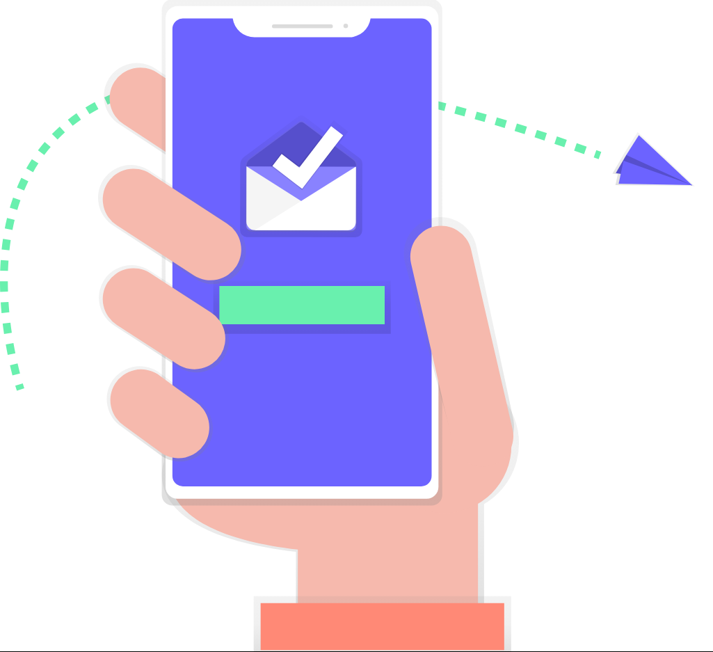
“Reach Out”
To "reach out" means to initiate contact with someone, often for the purpose of communication, collaboration, or seeking assistance. It involves extending a line of communication to establish a connection.
Aspire
10
Notes:
Def: getting in contact with someone
Ex: feel free to reach out if you have any questions we may heard this phrase atleast once in a week from out trainers

Slide 11

“Cut Corners”
To "cut corners" means to do something in a quick and careless way by omitting important steps or ignoring standard procedures to save time or effort. It often results in lower quality work and potential errors.
Aspire
11
Notes:
Def: doing a task quickly and carelessly
ex: cutting corners can lead to poor quality work

Slide 12



“Back to the Drawing Board”
To go "back to the drawing board" means to start over with a project or plan after it has failed or been rejected. It involves reassessing the approach and developing new ideas or strategies from scratch.
Aspire
12
Notes:
Def: starting over with new ideas
ex: the client rejected the proposal, so its back to the drawing board.

Slide 13

“Thank You”

